Slide 1
Java ByteArrayOutputStream class
ByteArrayOutputStream is an implementation of an output stream that uses a byte array as the destination. The buffer automatically grows as data is written to it. The data can be retrieved using toByteArray() and toString().
Closing a ByteArrayOutputStream has no effect. The methods in this class can be called after the stream has been closed without generating an IOException.
ByteArrayInputStream
Java Application
Write
Write
ByteArray

Slide 2
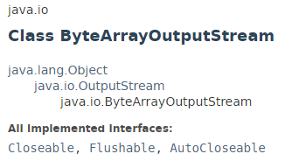
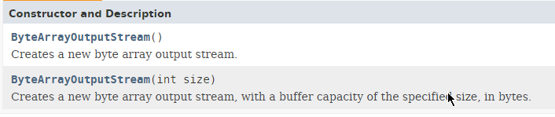
Java ByteArrayOutputStream class

Slide 3
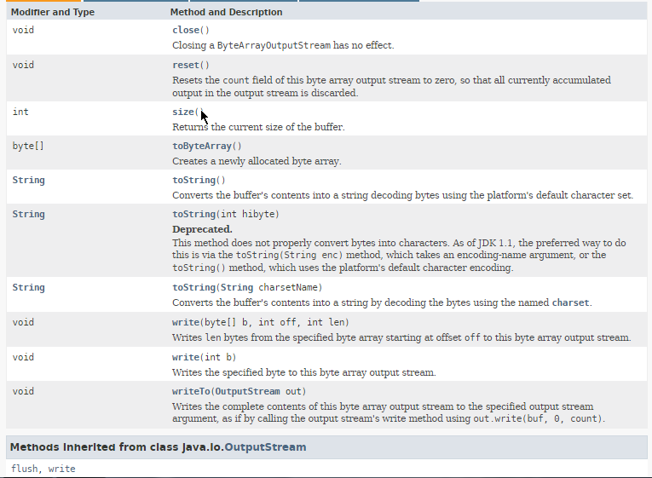
Java ByteArrayOutputStream class

Slide 4
Java ByteArrayOutputStream class
https://docs.oracle.com/javase/8/docs/api/index.html?java/io/ByteArrayOutputStream.html

